Slide 1
Monster Game
Team Members and Roles:
• Austin Kelsch – Role: Consultant
• Carl Reider – Role: Consultant
• Kyle Aldrich – Role: Consultant
• Tara Raj – Role: Consultant
• Stefan Barac – Role: Consultant
• Emma Highland – Role: Consultant

Slide 2
How it Works
User opens the game
Random # of monsters
User taps monsters-yellow disappear and points, green nothing
50 seconds to get all monsters
Score is updated - 1 point per monster

Slide 3
Overall Organization
Class/interface structure:
-Kept TouchMe class to control activity.
-MonsterActivity class to control the board.
-DotView to control the User Interface.
-ClockModel to run the game clock.
Key methods: (monsterGridMove, monsterMove, getIndexX/Y…)
Constants class

Slide 4
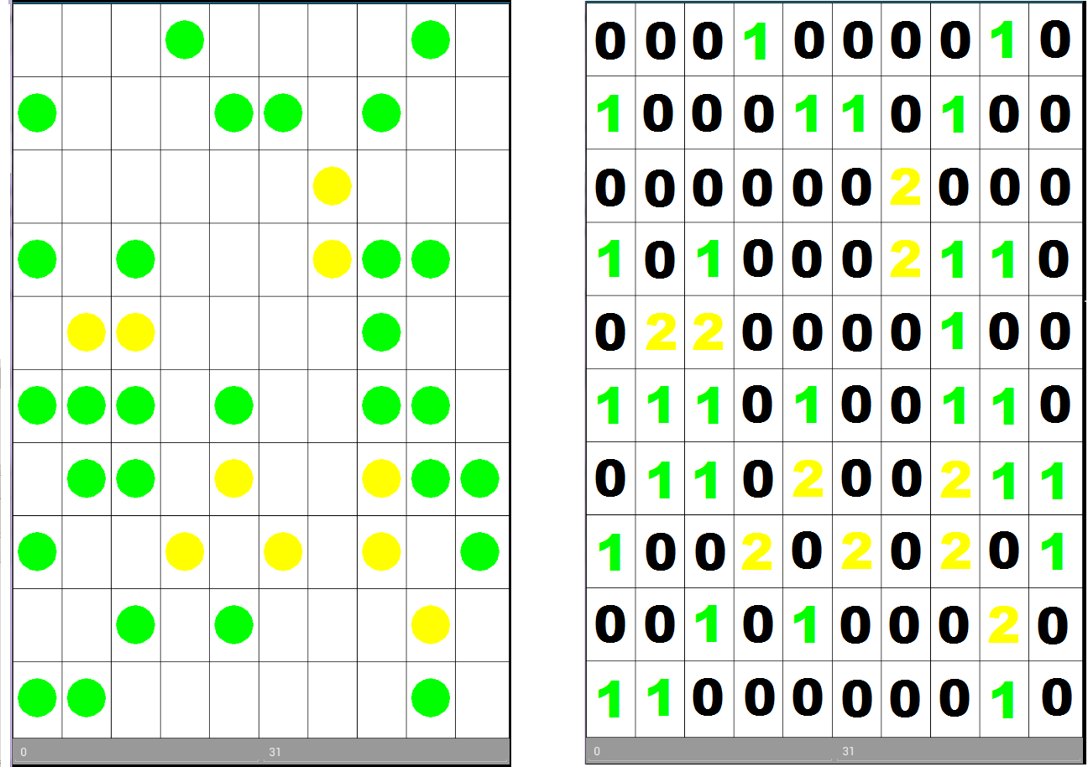
2D Array
Notes:
Figured this would be a good way to visualize for the class how the 2D array abstracts the actual UI. its also kind of the central part of how the project works, so we should devote a whole slide to it.

Slide 5
Testing
How did we test?
Mix of manual user and auto Junit
What kind of tests were run?
User play-through, Junit for functional systems
Who was responsible for what aspects of
game testing?
All devs for user, Kyle for automated

Slide 6
Biggest Challenges?
•What was hard about creating your game?
Figuring out the best way to represent the monster grid and transposing it to the UI
Creating a timer that would move the monsters ontick
Figuring out how to get the users touch coordinates and convert them into our 2d array coordinates
Implementing a constant updating score and timer
Introducing a popup window to stop the game and display the score
Managing several different versionxs of the project through bitbucket

Slide 7
Biggest Challenges? (continued)
•How did you overcome the challenges?
Brainstorming as a team
Not being hesitant to try different approaches
Seeing whether tests passed/failed
•What would you recommend to other teams who do this project in the future?
Start early!
Have open communication with other team members
Make sure everyone is involved in the developing and testing process

Slide 8
Demo Time!
Notes:
technically we dont have to show a demo if we dont want to i believe.

